Slide 1

Modernize Classic Site

Slide 2
Modernize Classic SharePoint sites
Modernize Branding and Customizations
Maximize the use of the Modern List and Library Experience
Connect site to M365 Group
Modern experience in SharePoint is created to be flexible, mobile and compelling. When compared with the classic SharePoint sites, the modern sites are featuring better functionality along with a beautifully designed new interface.
In-place modernization: is a way to fully transform (or "modernize") a classic site into a modern Microsoft 365 group-connected site by following these four steps.
Transform Wiki and Web Parts Pages to Modern Site Pages
Rebuild Classic Publishing Portals as Modern Portals

Slide 3
Broad Phases of Modernizations
03
02
EXECUTE
01
STRATEGY
ASSESSMENT

Slide 4
Steps for Assessment
01
ASSESSMENT
Step 1: Run SharePoint Modernization Scanner
Step 2: Run Custom Developed PowerShell (if required)

Slide 5
SharePoint modernization scanner
SharePoint Modernization scanner helps to prepare classic sites for modernization with the following modernization efforts -
Optimizing the usage of modern list and libraries
Rebuilding classic publishing portals as modern publishing portals
Modernizing the wiki and web part pages by creating modern site pages
Understanding the usage of classic blog pages
Connecting these sites to a Microsoft 365 group
Understanding where classic workflow & InfoPath Form is being used
The scanner is a key tool to use for modernizing classic sites as it will provide the factual data about the complexity to modernize sites.
Using the dashboards generated by the scanner "modernization readiness" can be drilled down and required remediation work can be identified.
Please refer to MS Site for more details - The SharePoint modernization scanner | Microsoft Docs

Slide 6
Steps for Strategy
02
STRATEGY
Step 1: Analysis of Non-Compatibility
Step 2: Analysis of Impact of Modernization options
Lists and Libraries Impact
Pages Impact
Branding Impact
Microsoft 365 group connect impact
Microsoft 365 group connect security impact
Teams team provisioning impact

Slide 7
Steps for Execution
03
Step 1: Maximize use of modern lists and libraries
EXECUTE
Step 2: Transform classic pages to modern pages
Step 3: Modernizing Scripts
Step 4: Modernizing Customizations
Step 5: Modernizing Branding
Step 6: Connect your site to an Office 365 group
Step 7: Modernizing Publishing Portal

Slide 8
Maximize use of modern lists and libraries
All lists and libraries cannot be transformed to modern experience because of -
List templates available in the modern user interface
List (100)
Document Library (101)
Links list (103)
Announcements list (104)
Contacts list (105)
Picture library (109)
Form library (115)
Site pages library (119)
Custom grid (120)
Promoted links list (170)
Publishing pages library (850)
Assets library (851)
Issue tracking list (1100)
Certain types of lists and libraries are not yet built by the SharePoint team to show up in a modern user interface; for example, a Task list or an Events list. For these people need to wait for the SharePoint team to implement a modern version, or switch over to an equivalent option.
Options include using Microsoft Planner instead of a classic Task list, or using the calendar of Microsoft 365 group instead of a classic SharePoint Events list calendar.
Certain types of lists and libraries can be shown in modern, but are blocked due to an incompatible configuration or customization; action can be taken here.

Slide 9
Maximize use of modern lists and libraries
Detect lists and libraries not available in the modern user interface using SharePoint Modernization scanner
Unblock lists and libraries that are blocked from modern experience because of the following reasons
  Incompatible customizations
  Existence of certain field types
  Modern and library user interface blocking at site or web level
  Modern and library user interface blocking at list level
  Lists that show up with BaseTemplate = 0
  Customized list view pages that contain more than the list XSLTListViewWebPart
Please refer to MS Site for more details - Maximize use of modern lists and libraries | Microsoft Docs

Slide 10
Modernizing Scripts
Category | Description
Microsoft 365 Group Connect | Contains scripts that show how to perform a bulk Microsoft 365 group connect. This is useful when the need is to group connect multiple site collections instead of leaving group connect as a task for site owners.
Page Transformation | Scripts that help with page transformation of Wiki, Web Part, Blog and Publishing Pages. There are scripts for transforming from SharePoint Online to SharePoint Online, but also scripts that handle transformation from SharePoint On-premises to SharePoint Online.
Modernize Site Collections | These scripts are modernizing a site collection by combining Microsoft 365 group Connect, Page Transformation, cleaning up branding, creating a Teams ,... The scripts can work for a single site collection, but you can also provide a list of site collections to be modernized.
List and Libraries | To force certain site collections to show all lists using their classic rendering, then these scripts will be used.
Please refer to MS Site for more details - https://docs.microsoft.com/en-us/sharepoint/dev/transform/modernize-sample-scripts

Slide 11
Transform classic pages to modern pages
The SharePoint PnP Modernization Framework (Nuget, source code) does bring page transformation capabilities. Page transformation today works for Wiki Pages, Web Part Pages, (Delve) Blog Pages and Publishing Pages. Page transformation can be used in one or more of the below models:
Model | Technique | Audience | Publishing Page support | Comments
I want to transform pages for my users | PowerShell | DevOps | Yes | Typically used when there is a need to modernize pages for multiple site collections. Using PowerShell is the easiest and recommended approach.
I want to have full control on the page transformation process | .Net | DevOps | Yes | Typically used when integrate page transformation into existing services or tools. The core of page transformation is the .Net based SharePoint PnP Modernization framework. Using .Net with fully tailor transformation process, this approach is recommended for full control on the transformation process or when need to integrate page transformation into another solution/product.
Please refer to MS Site Transform classic pages to modern pages | Microsoft Docs for more details

Slide 12
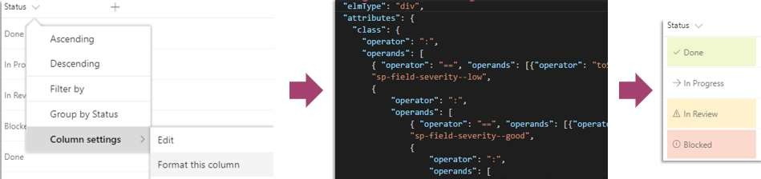
Modernizing Customizations
Replace JS embed or JS Link scenarios by SharePoint Framework extensions
Replace JS Link scenarios by SharePoint Column Formatting
Custom menu items in the site actions menu ,Currently it's not possible to add your own custom menu items to the site actions menu (the gear icon) on modern pages. Alternative strategies you can follow are adding the needed links into the site's navigation or by adding the needed links on the site's home page
Please refer to MS Site for more details - https://docs.microsoft.com/en-us/sharepoint/dev/transform/modernize-customizations

Slide 13


Modernizing Branding
The SharePoint modern user interface handles branding differently from classic SharePoint; in particular, it simply ignores custom master pages or alternate CSS configurations (which are incompatible in the modern user interface).
Plan to leave these configurations in place in modernized site so that it still applies to a page being shown in a classic user interface, but it's cleaner to switch back the OOB master pages and remove the alternate CSS configuration.
Next to these master pages and alternate CSS settings, plan to use a classic custom theme.
Classic custom themes work on both classic and modern pages, but the more future-proof model is the new tenant-controlled SharePoint theme, which obviously applies to both classic and modern pages
Detect sites that use master pages or alternate CSS
The recommended approach to find out which sites use a custom master page or use the alternate CSS option is to run the SharePoint Modernization scanner.
This tool performs a deep analysis of all the sites in tenant and creates reports that gives details about sites that still have incompatible master pages or alternate CSS settings.
Based on the scanner output, plan to remediate these sites.
Revert back to the default configuration
Connect-PnPOnline -Url "<your site url>" # Set out-of-the-box master page Set-PnPMasterPage -MasterPageSiteRelativeUrl _catalogs/masterpage/seattle.master -CustomMasterPageSiteRelativeUrl _catalogs/masterpage/seattle.
Please refer to MS site below for more details - https://docs.microsoft.com/en-us/sharepoint/dev/transform/modernize-branding

Slide 14
Modernizing Branding
Use a tenant-controlled SharePoint theme
Use your company SharePoint theme
SharePoint offers a series of default themes out-of-the-box that can be used, but if there is a push from company branding, we recommend to create company theme and hide the out-of-the-box themes.
After that configuration, users can only select from the company SharePoint themes that have been configured, and allows to programmatically set such themes as part of the modernization effort.
Import-Module SharePointPnPPowerShellOnline -DisableNameChecking -MinimumVersion $minimumVersion
Connect-PnPOnline -Url "<your site url>"
# Set the company theme Set-PnPWebTheme -Theme "CustomCompanyTheme"
Please refer to MS Site for more details - https://docs.microsoft.com/en-us/sharepoint/dev/transform/modernize-branding

Slide 15
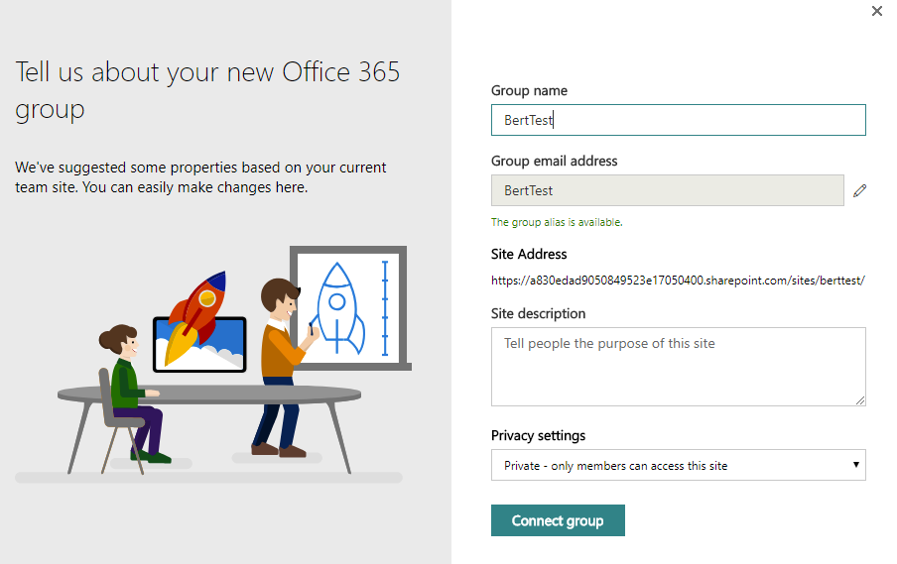
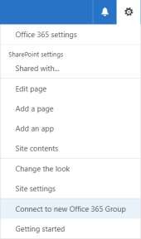
Connect site to an Office 365 Group
1/2
Connect a Microsoft 365 group using the SharePoint user interface
One approach to connect a Microsoft 365 group to site is to use the option available in the user interface. By selecting the gear icon in the navigation bar, and select the Connect to new Microsoft 365 group option, which launches a wizard that walks you through the group-connection process as shown in the following screenshots.
+
Please refer to MS Site for more details - https://docs.microsoft.com/en-us/sharepoint/dev/transform/modernize-connect-to-office365-group

Slide 16
Connect site to an Office 365 Group
2/2
Programmatically connect a Microsoft 365 group
LEARN
ANALYZE
MODERNIZE
Learn what group-connection does to site
Analyze the required sites
Modernize the sites
The user interface option is not suitable if there is a need to group-connect hundreds of site collections.
Using an API is the preferred approach. But it's recommended to verify which sites are ready to be group-connected because not all sites are suitable for this.
Use the SharePoint Modernization Scanner to analyze environment and the Understand and process the scanner results to analyze the scan results.
The bulk group-connect process consists of two steps:
  Prepare and validate an input file that will use to drive the bulk group-connect process.
  Run the bulk group-connect process.
REST: POST _api/GroupSiteManager/CreateGroupForSite
CSOM: Tenant.CreateGroupForSite()
OOB SharePoint Online PS: Set-SPOSiteOffice365Group
SharePoint PnP PowerShell: Add-PnPOffice365GroupToSite
Getting familiar with what group-connection does to site is important
Recommendation is to do a manual group-connection for some test sites by using the user interface option.
Evaluate whether there is a need to keep the newly created modern home page.
As part of the modernization script, that allow users to create a tailored home page, but if the default one serves the needs, that's the preferred option.
Please refer to MS Site below for more details - https://docs.microsoft.com/en-us/sharepoint/dev/transform/modernize-connect-to-office365-group

Slide 17
Modernizing Publishing Portal
Activity | Approach
Information Architecture | Designing and building the Information Architecture for a new portal is a manual effort. This includes building a new site structure and defining the future metadata model that will be used. The modern portal will start with new site collections and this new start is an opportunity to start "clean" as well.
Document and List Item Migration | If any classic portal has document libraries and lists with information that need to be retained, then these need to be copied over to the new libraries and lists in the newly created site collections. For this plan for either use the built-in SharePoint Online copy features or use third party migration tooling.
Branding and Customizations | Classic portals often used a heavily customized user interface and lot's of customizations. For modern portals there's less need for this, but if there is a need customizations then we’ll have to recreate the needed customizations using techniques that allow them to work on modern portal pages.
Transformation of the Page Content | If there is a large volume of pages to migrate it makes sense to automate this using the PnP Page Transformation technology. Plan to have fine grained control on what page content ends up on the new page, what content becomes metadata and much more via page layout templates.
Home Pages | Home pages typically do not lent themselves very well for an automated transformation given the underlaying information architecture differences between the classic and modern portal, hence it's recommended to manually create the new home pages.
Please refer to MS site below for more details - https://docs.microsoft.com/en-us/sharepoint/dev/transform/modernize-publishing-portal

Slide 18
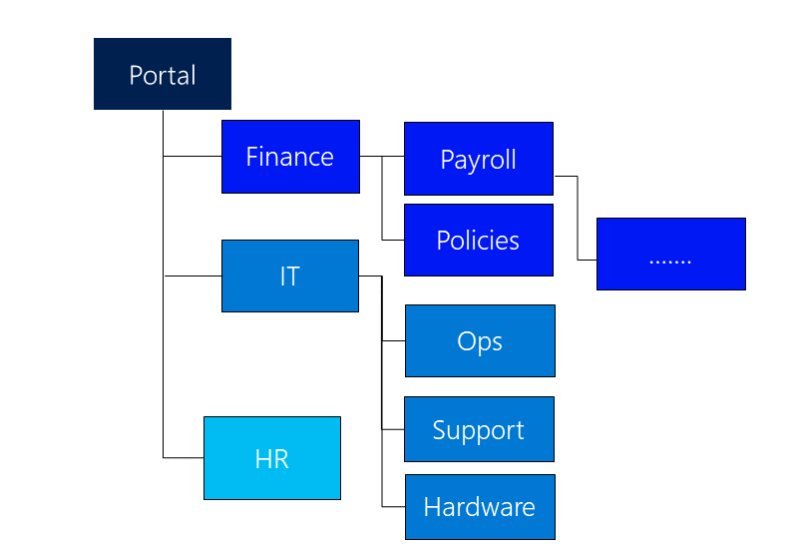
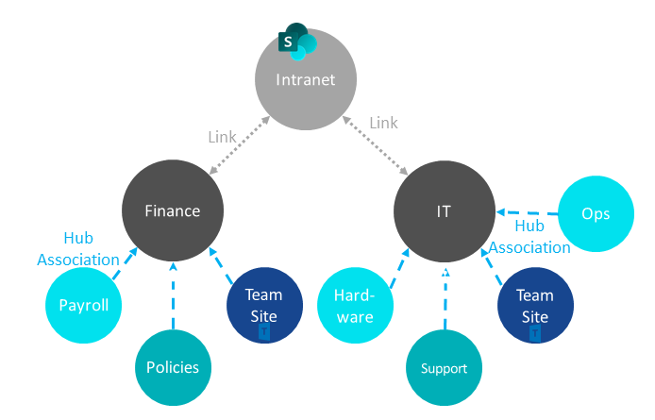
Modernizing Publishing Portal
Information Architecture
Classic Portals typically are using deeply nested site structures as shown above. In each site there's Pages library holding pages that are associated with a given content type (page metadata) and page layout (page wire frame).
In ModernIintranets, recommends is to use individual communication sites instead of sub sites (potential to consolidate/deprecate certain of the sub sites) and then where need create a flexible hub-spoke model by designating some site collections to be a hub and joining other site collections to that hub.

Slide 19
References
https://docs.microsoft.com/en-us/sharepoint/dev/transform/modernize-scanner
https://docs.microsoft.com/en-us/sharepoint/dev/transform/modernize-classic-sites
https://docs.microsoft.com/en-us/sharepoint/publishing-sites-classic-to-modern-experience
https://docs.microsoft.com/en-us/sharepoint/dev/transform/modernize-userinterface-site-pages-powershell
https://twitter.com/jeffteper/status/1045159986291200000
https://support.office.com/en-us/article/SharePoint-site-contents-page-ba495c1e-00f4-475d-97c7-b518d546566b
Why move from publishing sites to communication sites? - SharePoint - SharePoint in Microsoft 365 | Microsoft Docs

Slide 20
Thank You

